Slide 1

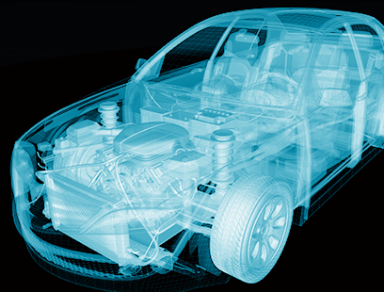

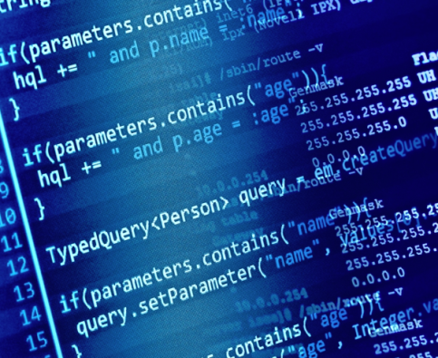
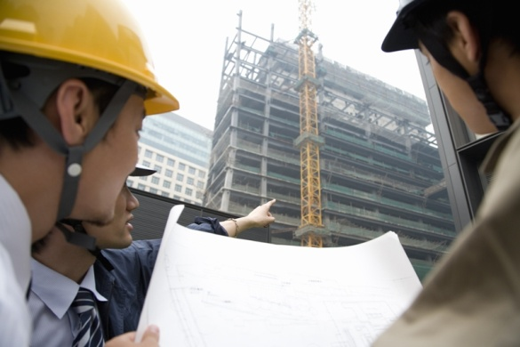
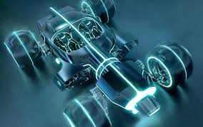
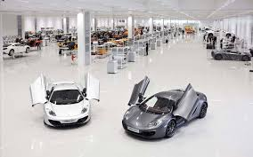
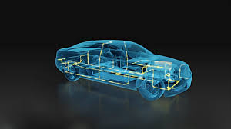
Car Parts Detection Using Yolov3
Date: 05-May-2021

Slide 2
Car Parts Detection using YOLOv3
In this project we detect the car pats using YOLOv3 (You Only Look Once version 3) computer vision type algorithm
We have detected five parts of a car
Light (Front Light and Back Light)
Glass (Front Glass and Back Glass)
Side Glass
Door
Wheel
Pre-requisites:
Google Colab, Tensorflow version =1.15.2, Keras version = 2.2.4, VoTT Annotation Tool
Clone the github repository https://github.com/bhadreshpsavani/CarPartsDetectionChallenge/ inside the local system

Slide 3
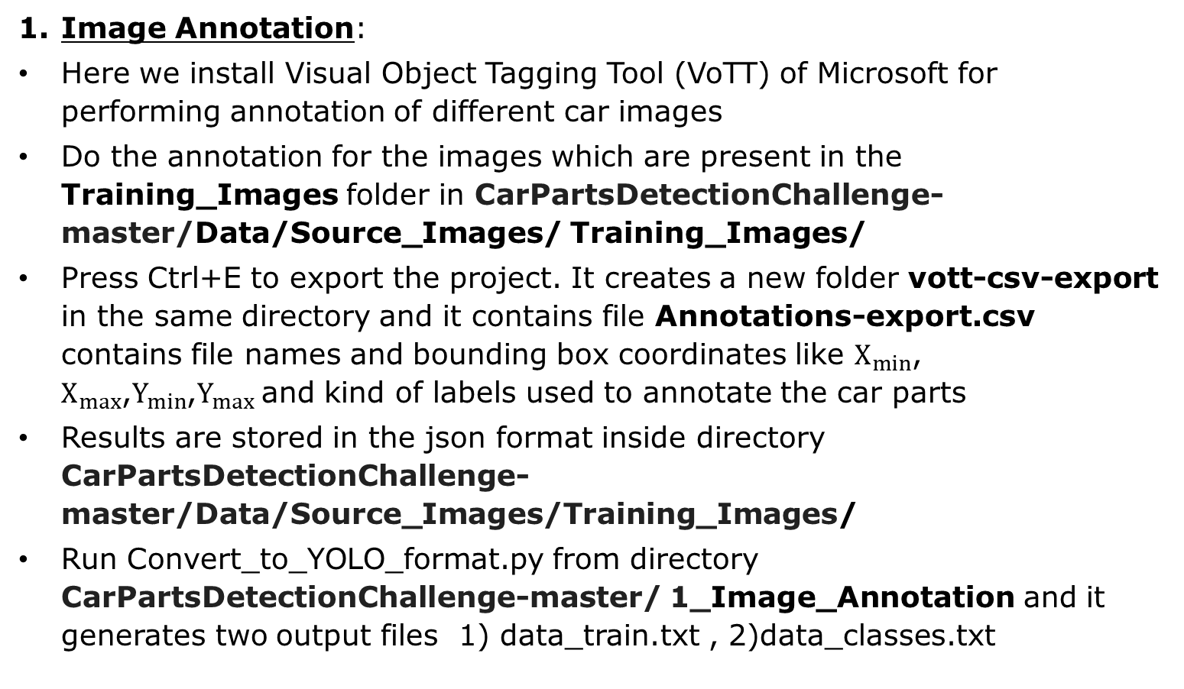
Steps
Image Annotation:
Here we install Visual Object Tagging Tool (VoTT) of Microsoft for performing annotation of different car images
Do the annotation for the images which are present in the Training_Images folder in CarPartsDetectionChallenge-master/Data/Source_Images/ Training_Images/
Press Ctrl+E to export the project. It creates a new folder vott-csv-export in the same directory and it contains file Annotations-export.csv contains file names and bounding box coordinates like $X_{min}$, $X_{max}$,$Y_{min}$,$Y_{max}$and kind of labels used to annotate the car parts
Results are stored in the json format inside directory CarPartsDetectionChallenge-master/Data/Source_Images/Training_Images/
Run Convert_to_YOLO_format.py from directory CarPartsDetectionChallenge-master/ 1_Image_Annotation and it generates two output files 1) data_train.txt , 2)data_classes.txt

Slide 4
Steps Contd….
Training the YOLO Model:
First download the pre-trained weights
Train our own YOLO model on the annotated images
Inference:
Performs object detection on the new images
Displays the name of the part on the bounding box and IOU(Intersection over union) score of area covered by the bounding box for that particular part.
If IOU score >0.5 , it is good prediction
Note: Steps 2 and 3 are to be run inside Google Colaboratory platform
Upload the entire CarPartsDetectionChallenge-master/ folder inside the Google Drive
Notes:
In order to apply Intersection over Union to evaluate an object detector we need:
The ground-truth bounding boxes (i.e., the hand labeled bounding boxes from the testing set that specify where in the image our object is).
The predicted bounding boxes from our model.
IOU=Area of Overlap/Area of Union

Slide 5
Phase 1

Slide 6
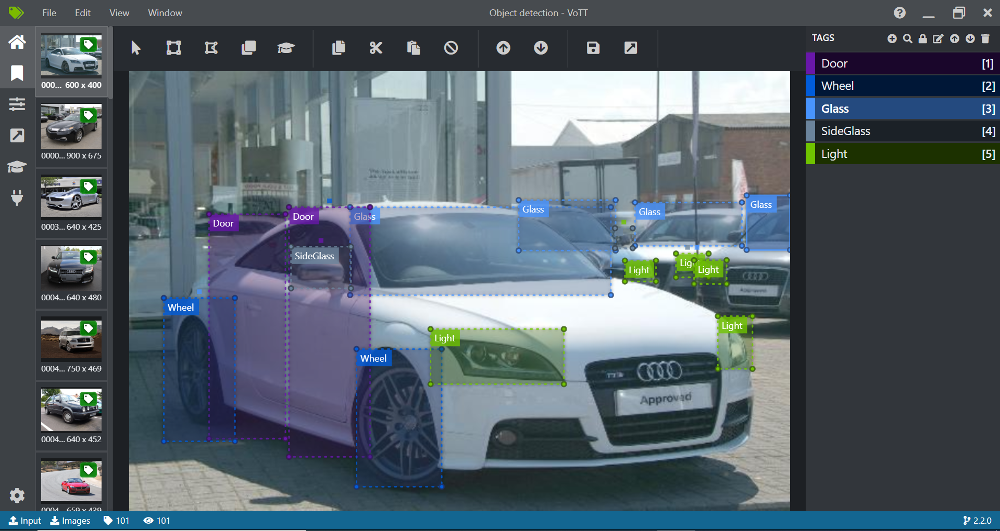
Step 1: Results of Image Annotation using VoTT

Slide 7
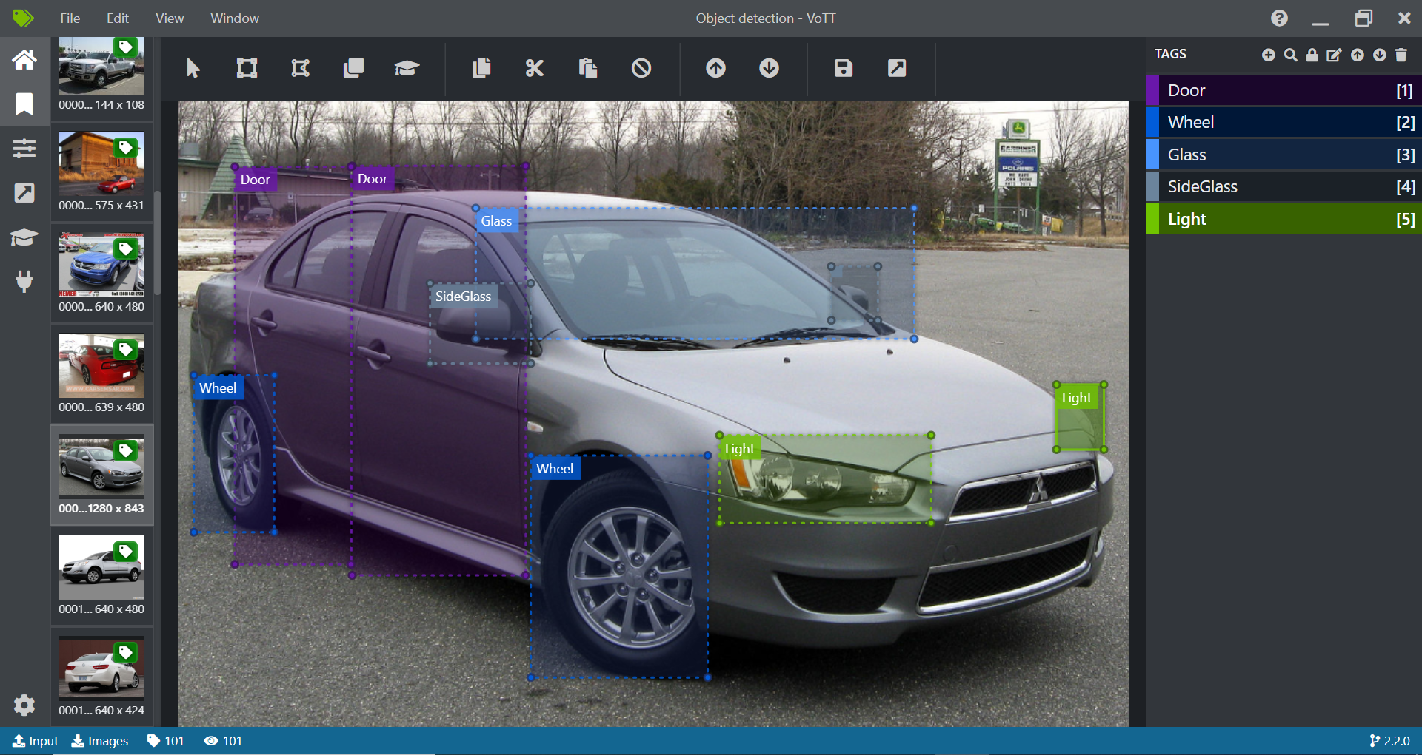

Slide 8
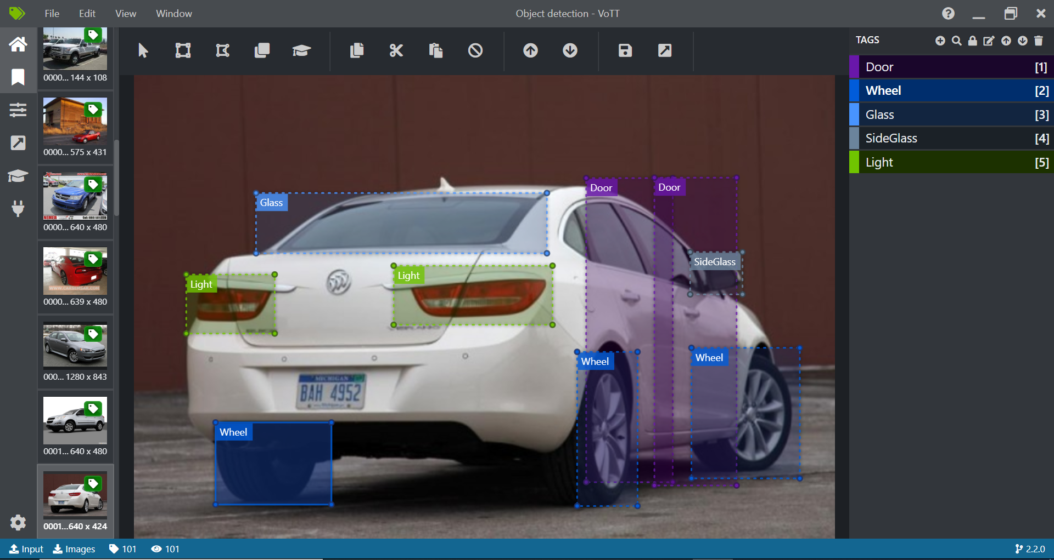

Slide 9
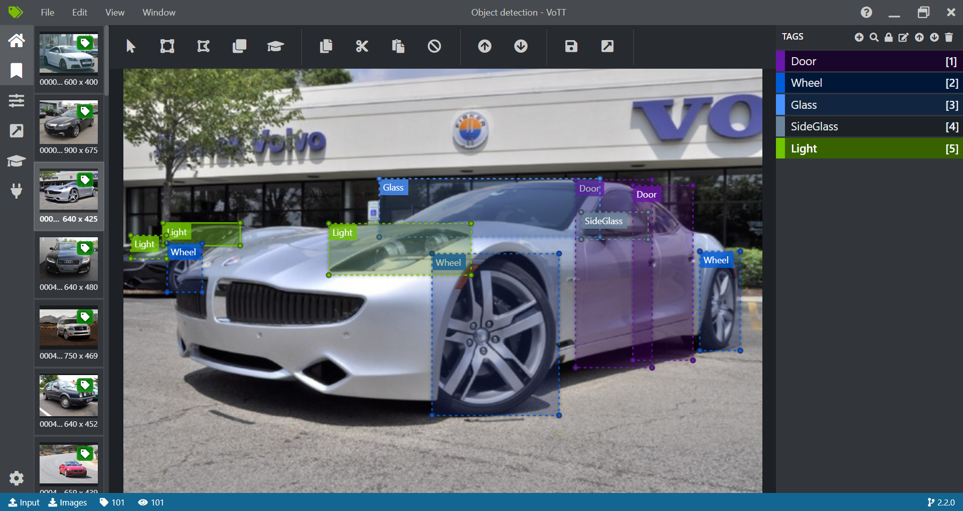

Slide 10
Step 1.1: Detecting bounding box for annotated parts and convert to YOLO format
Mount your Google Drive and set up the repository and Google Colab
Run the following codes
Minimal_Example.py –
Go to directory /content/drive/MyDrive/CarPartsDetectionChallenge-master/ path in the Google Drive to run the file
The outputs are saved in /content/drive/MyDrive/CarPartsDetectionChallenge-master/Data/Source_Images/Test_Image_Detection_Results
Includes car pictures with bounding boxes around faces with confidence scores and Detection_Results.csv file with file names and locations of bounding boxes.
Convert_to_YOLO_format.py -
Go to directory /content/drive/MyDrive/CarPartsDetectionChallenge-master/1_Image_Annotation/ path in the Google Drive to run the file
Prepares the dataset for training YOLO model

Slide 11
Step 2: Training the YOLOv3 Model
Go to directory /content/drive/MyDrive/CarPartsDetectionChallenge-master/2_Training/ in the Google Drive to run the below mentioned files
Download_and_Convert_YOLO_weights.py –
It downloads the pre-trained yolov3 weights and convert them to the keras format
Train_YOLO.py –
Runs the YOLOv3 model with the help of keras and tensorflow packages
Creates YOLOv3 model with 9 anchors and 5 classes
Freeze the first 249 layers of total 252 layers
Training done on 91 samples, validation done on 10 samples with batch size 32
The final weights are saved in /content/drive/MyDrive/CarPartsDetectionChallenge-master/Data/Model_weights

Slide 12
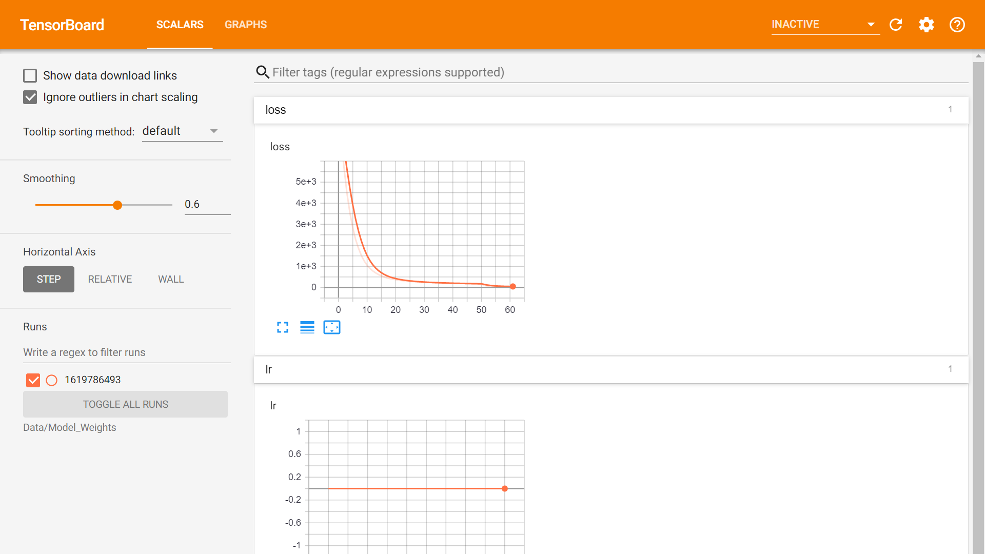
Results in Tensorboard
%load_ext tensorboard
%tensorboard --logdir Data/Model_Weights

Slide 13
Step 3: Run Inference
Go to directory /content/drive/MyDrive/CarPartsDetectionChallenge-master/ to run Minimal_Example.py. The results are same as in step 2
Go to directory /content/drive/MyDrive/CarPartsDetectionChallenge-master/3_Inference/ path to run file Detector.py
Detector.py –
Tests the trained model on the new images and results are stored in /content/drive/MyDrive/CarPartsDetectionChallenge-master/Data/Source_Images/Test_Image_Detection_Results/ path in the Google Drive

Slide 14
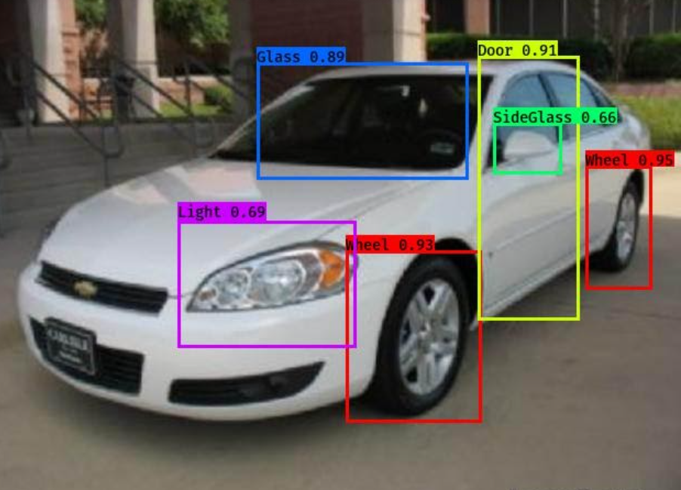
Results of Object Detection using YOLOv3

Slide 15
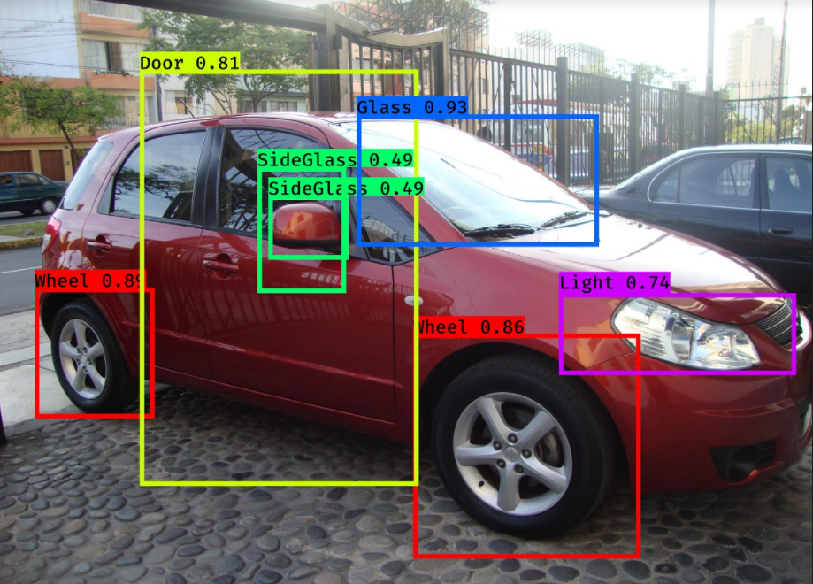

Slide 16
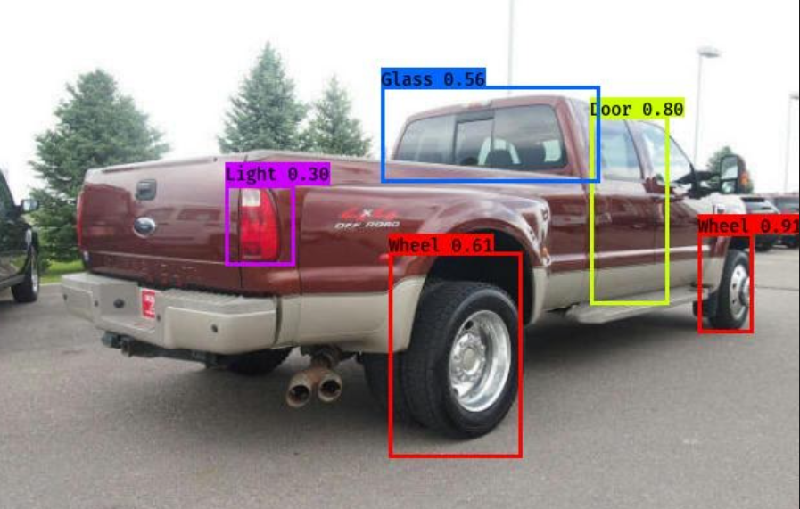

Slide 17
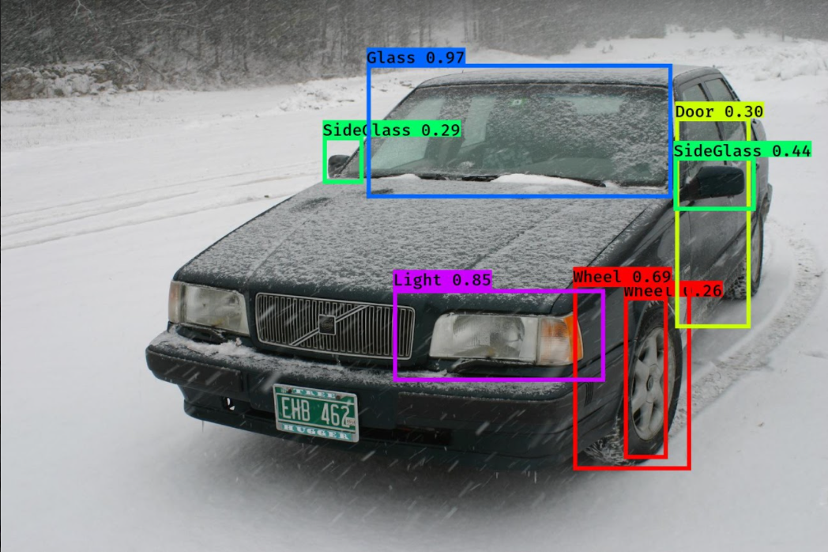

Slide 18
Phase 2

Slide 19
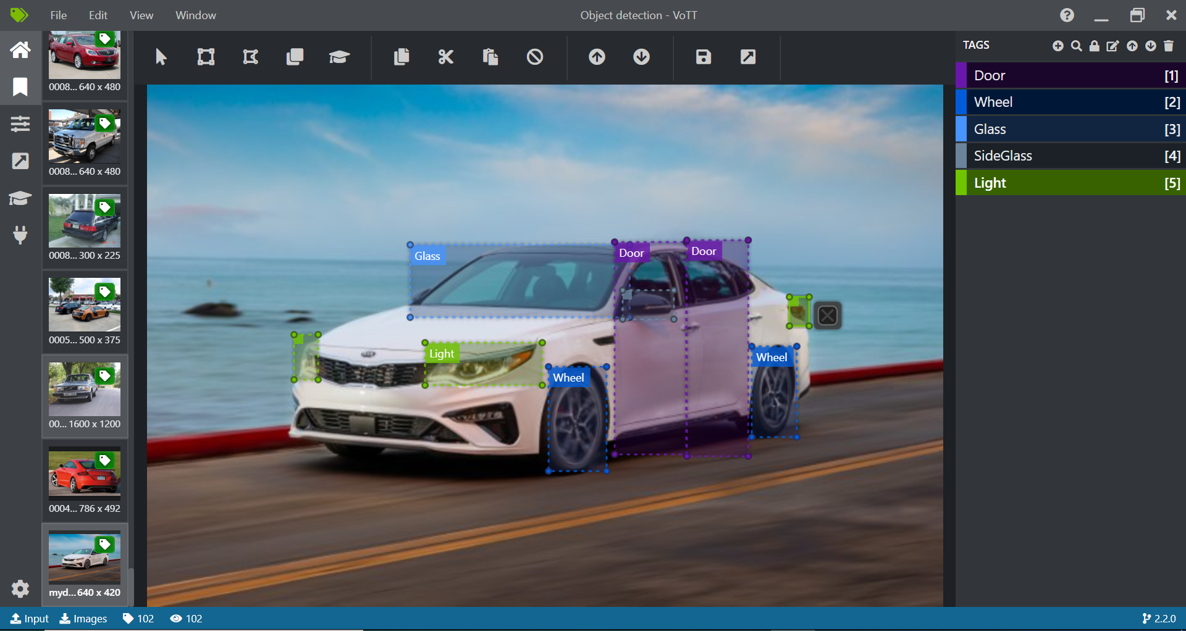
Using our own data for training YOLOv3 Model
Annotation using VoTT
In this step we download any car image from google and use it for object detection using YOLOv3
Place the image inside CarPartsDetectionChallenge-master/ Data/Source_Images/Training_Images/ directory
Annotate the image using VoTT

Slide 20
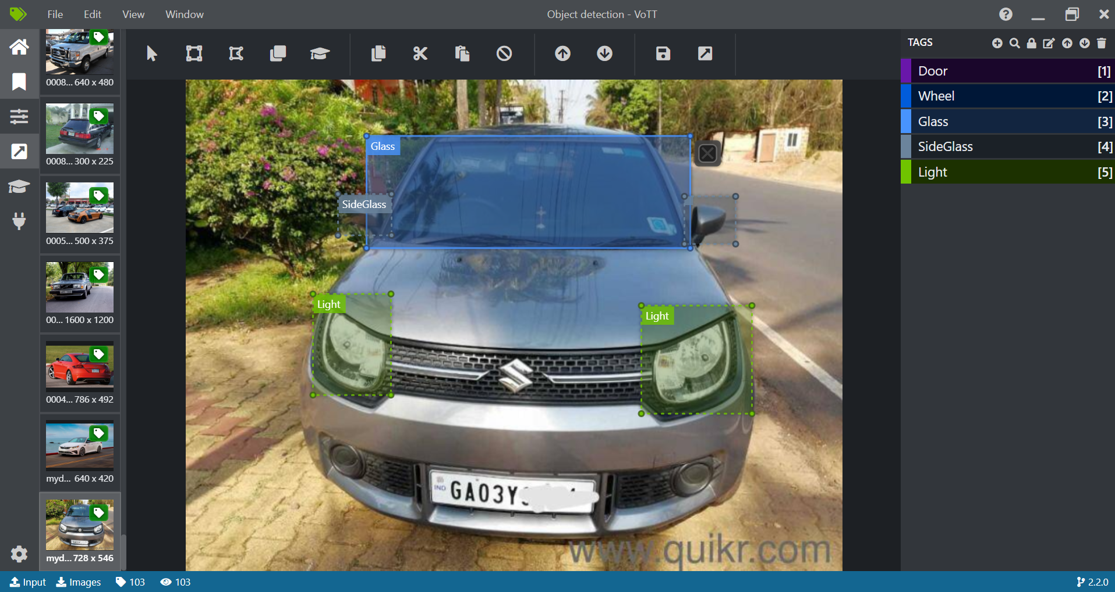

Slide 21
Object Detection of Car Parts for our own data
Follow step 1 to 3
Use your image data and upload in /content/drive/MyDrive/CarPartsDetectionChallenge-master/Data/Source_Images/Training_Images/vott-csv-export/
Upload your own inference data to the test image folder /content/drive/MyDrive/CarPartsDetectionChallenge-master/Data/Source_Images/Test_Images/
Run the entire Detector.py code and the result gets stored in /content/drive/MyDrive/CarPartsDetectionChallenge-master/Data/Source_Images/Test_Image_Detection_Results/
Next step - Only use the image data (unseen data) from Test_Images folder without uploading it in Training_Images folder and without running Train_YOLO.py code.
Run only Minimal_Example.py and Detector.py codes and check the results in /content/drive/MyDrive/CarPartsDetectionChallenge-master/Data/Source_Images/Test_Image_Detection_Results/

Slide 22
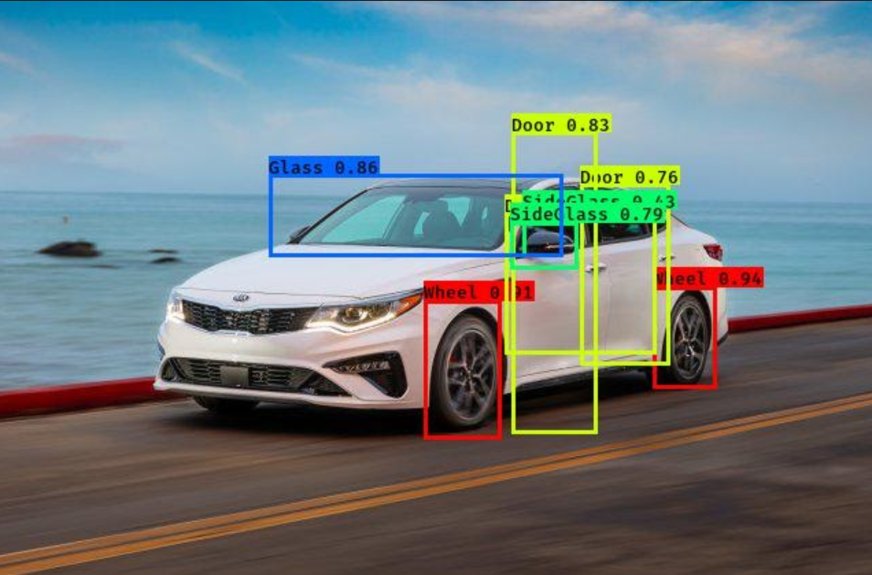
Result of Object Detection using YOLOv3 for our own data for training and testing

Slide 23
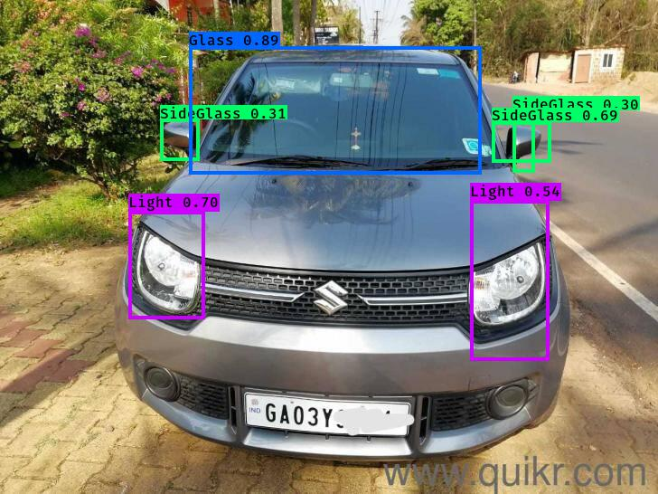

Slide 24
Phase 3

Slide 25
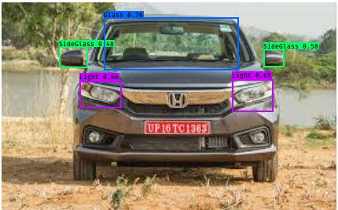
Result of Object Detection using YOLOv3 on unseen data

Slide 26
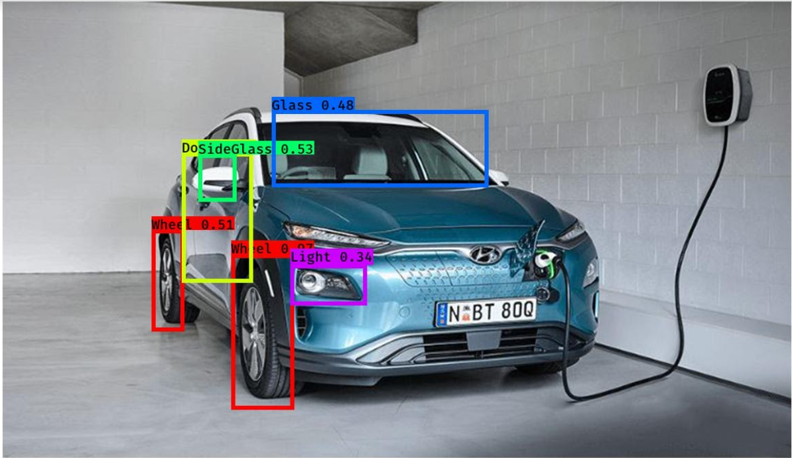

Slide 27
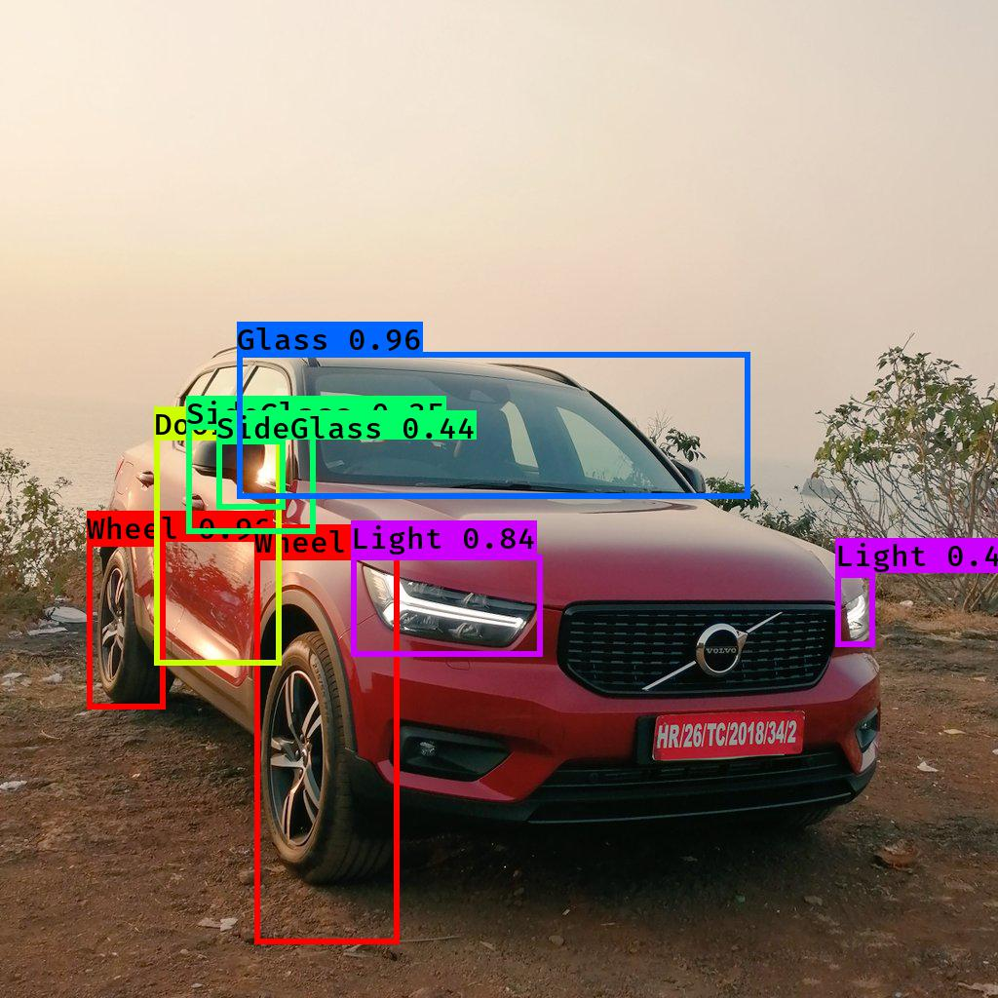

Slide 28
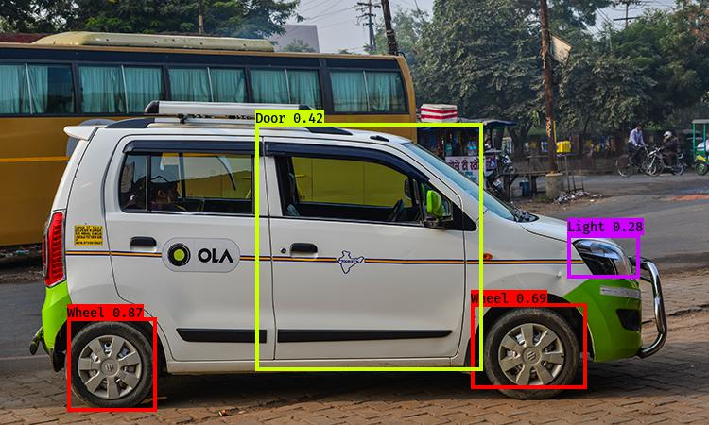

Slide 29
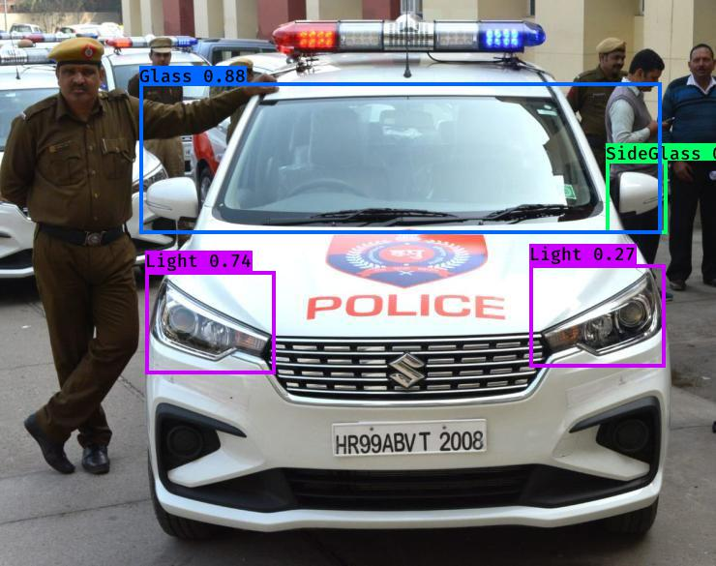

Slide 30
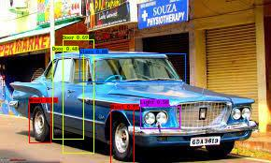

Slide 31
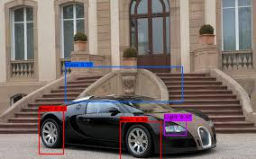

Slide 32
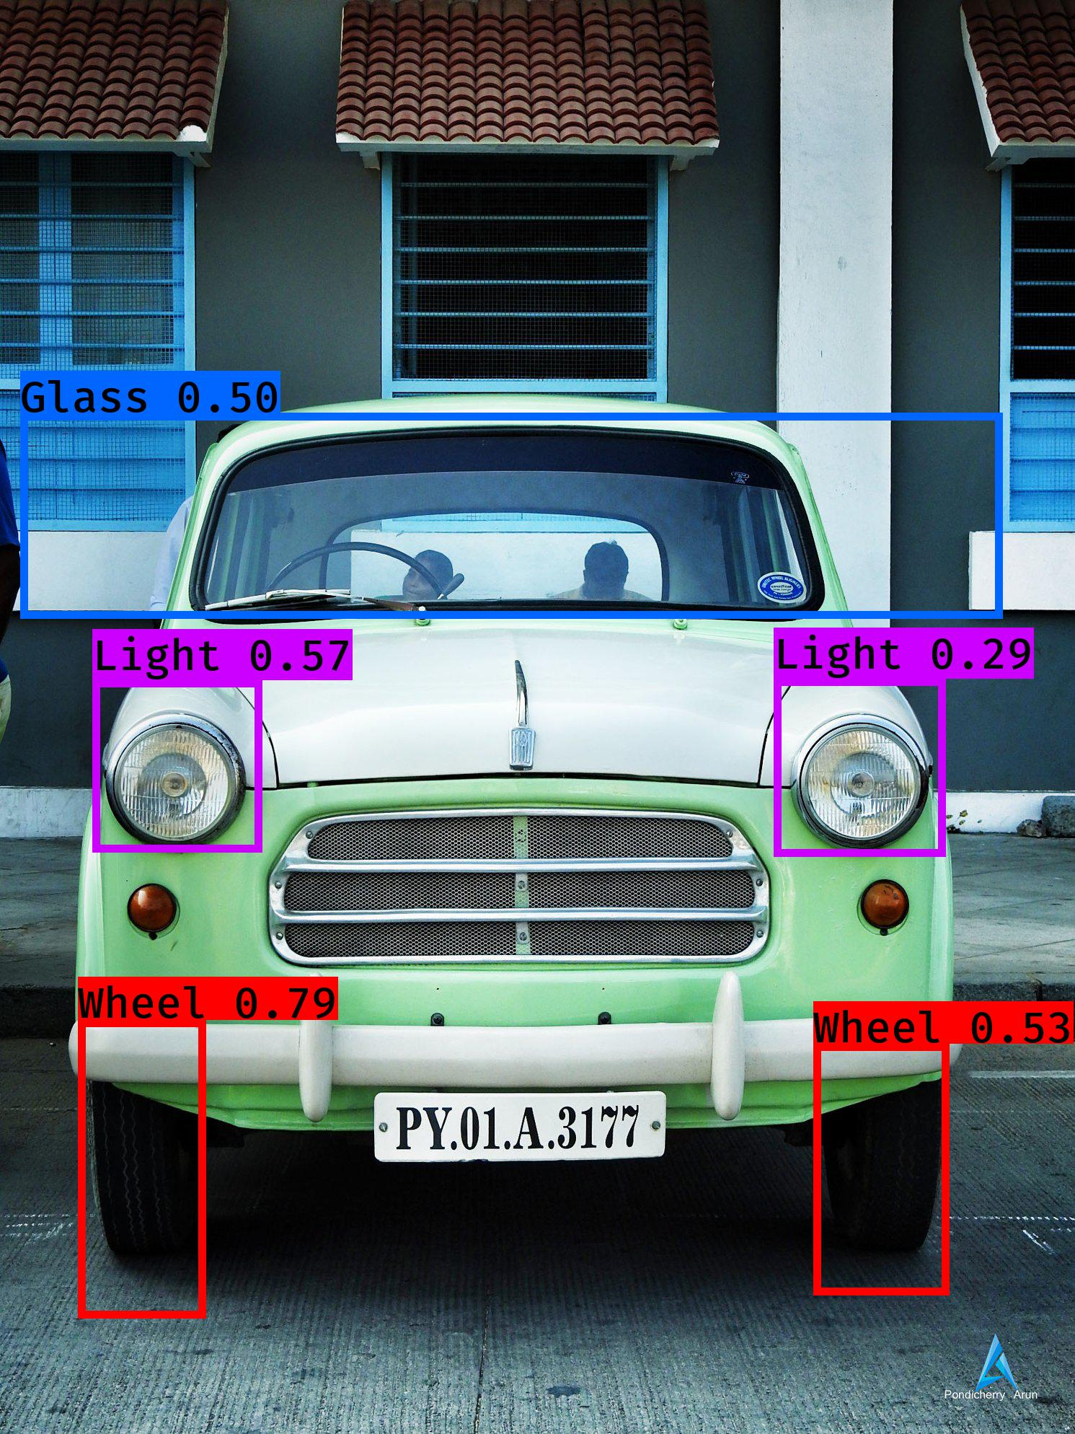

Slide 33
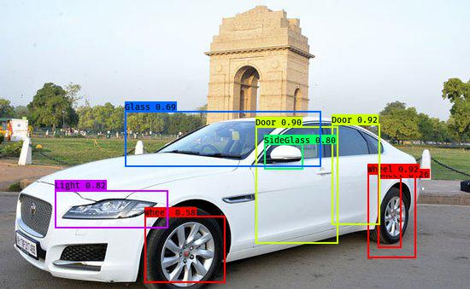

Slide 34
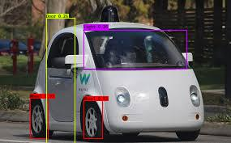

Slide 35
Average Confidence Score Table
Label Index | Label | Confidence Score in Phase1 | Confidence Score in Phase2 | Confidence Score in Phase3
0 | Light | 0.591444 | 0.618585 | 0.511663
1 | Glass | 0.745640 | 0.872962 | 0.716830
2 | Side Glass | 0.490936 | 0.506028 | 0.490544
3 | Door | 0.638261 | 0.667751 | 0.586294
4 | Wheel | 0.746288 | 0.925647 | 0.794101
 | Average Confidence Score | 0.660311 | 0.669127 | 0.640702

Slide 36
References
https://github.com/bhadreshpsavani/CarPartsDetectionChallenge/
https://pjreddie.com/media/files/papers/YOLOv3.pdf
https://pjreddie.com/darknet/yolo/
https://arxiv.org/pdf/1506.02640.pdf
https://www.pyimagesearch.com/2016/11/07/intersection-over-union-iou-for-object-detection/

Slide 37

Address:
TPRI Technologies India Pvt Ltd,
9th Floor, Trifecta Adatto, ITPL Main Road,
Mahadevapura, Bengaluru, Karnataka, 560048
India | www.technopro.com/en
37

Slide 38
38

